Slide 1
Dynodroid: An Input Generation System for Android Apps
Aravind Machiry Rohan Tahiliani Mayur Naik Georgia Institute of Technology

Slide 2
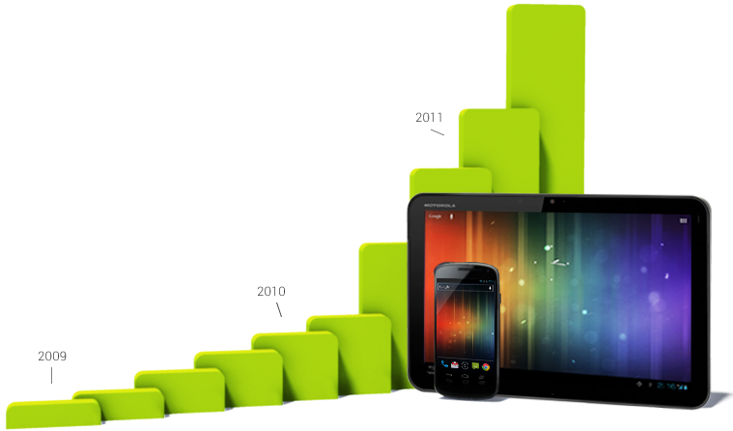
The Growth of Smartphones and Tablets
1 million new Android devices activated every day
750 million total (March 2013)

Slide 3
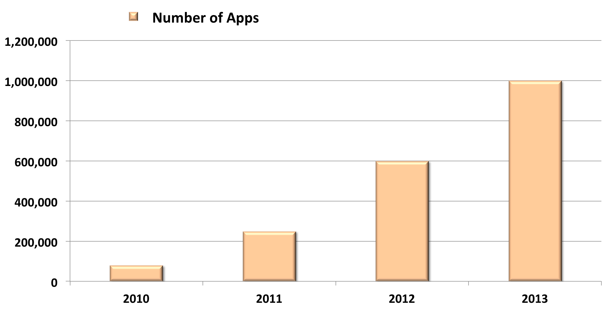
The Growth of Mobile Apps
30K new apps on Google Play per month
1 million total (July 2013)

Slide 4
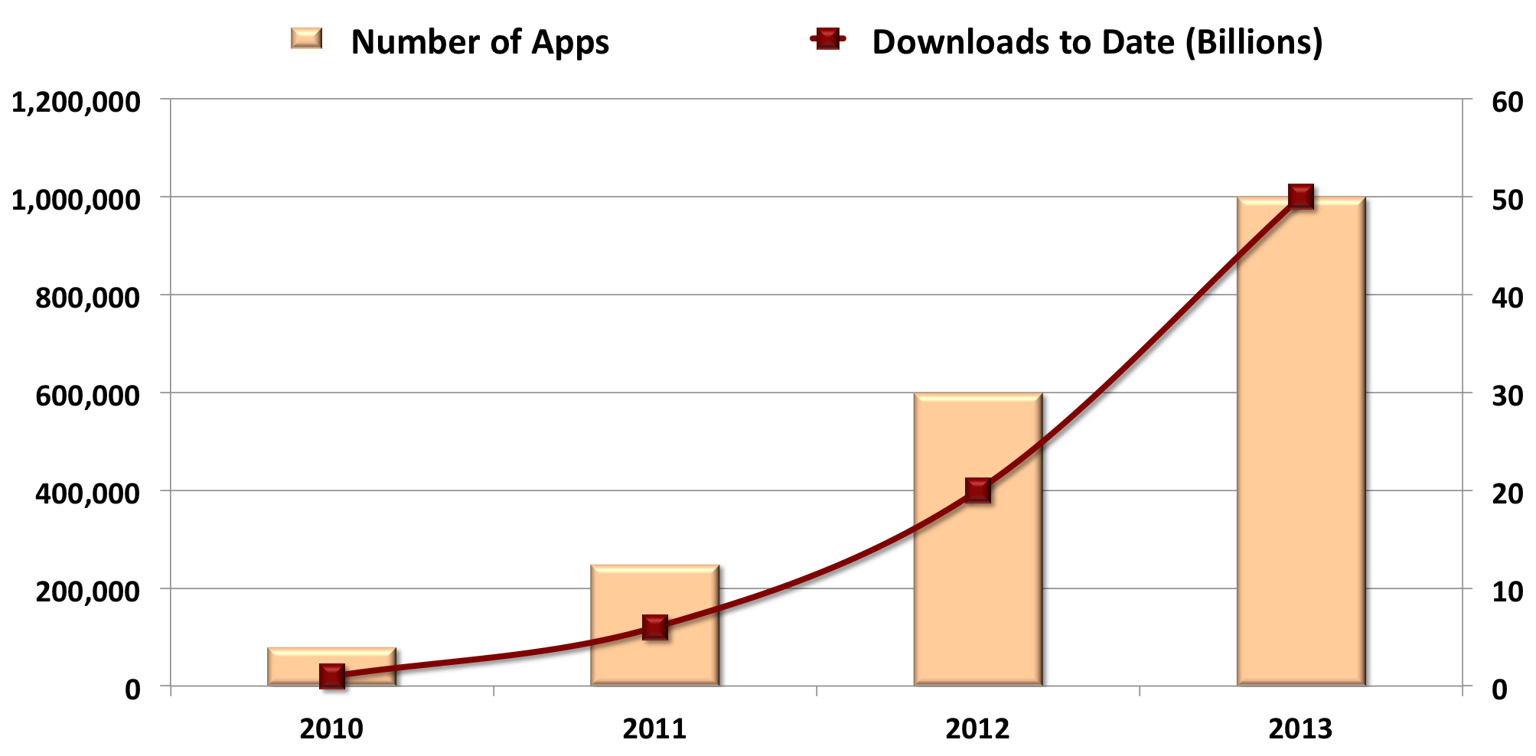
The Growth of Mobile Apps
1.5 billion downloads from Google Play per month
50 billion total (July 2013)

Slide 5




The Life of a Mobile App
Reliability
Security
Performance
Development and testing
Pre-deployment Certification
Post-deployment Adaptation
New software engineering problems in all stages
) need new program analysis-based tools

Slide 6
Program Analysis for Mobile Apps
Static Analysis
Program analysis using program text
Hindered by features common in mobile apps
Large SDK, obfuscated and native code, concurrency, IPC, databases, GUIs, …
Dynamic Analysis
Program analysis using program runs
Needs test inputs yielding high app coverage
Focus of our work

Slide 7
Desiderata for Input Generation System
Robust: handles real-world apps
Black-box: does not need sources or ability to decompile binaries
Versatile: exercises important app functionality
Automated: reduces manual effort
Efficient: avoids generating redundant inputs

Slide 8
Our Contributions
Design of a system Dynodroid satisfying the five desired criteria
Open-source implementation of Dynodroid on the dominant Android platform
Evaluation of Dynodroid on real-world apps against state-of-the-art approaches

Slide 9
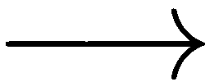
Our Approach
View an app is an event-driven program
Broadly two kinds of events:
UI event: LongTap(245, 310), Drag(0, 0, 245, 310), …
System event: BatteryLow, SmsReceived(“hello”), ...
Assumption: Fixed concrete data in each event and environment (sdcard, network, etc.)
May cause loss of coverage
e1
e2
e3
s0
s1
s2
s3 . . .

Slide 10
Relevant Events
Key challenge: Large number of possible events
E.g., 108 system events in Android Gingerbread
Insight #1: In any state, few events are relevant
) vast majority of events are no-ops
Insight #2: Can identify relevant events by lightly instrumenting SDK once and for all
) Does not require instrumenting app

Slide 11
Observe-Select-Execute Algorithm
s0
executor
s1
executor
s2
¢ ¢ ¢
e1
observer
e2
observer
e3
E1
selector
E2
selector
Statelessness does not cause any coverage loss in principle provided:
observer treats “restart app” event always relevant
selector is fair

Slide 12
Event Selection Algorithms
Frequency
Selects event that has been selected least often
Drawback: deterministic => unfair
UniformRandom
Selects event uniformly at random
Drawback: does not consider domain knowledge; no distinction of UI vs. system events, contexts in which event occurs, frequent vs. rare events
BiasedRandom
Combines benefits of above without drawbacks

Slide 13
BiasedRandom Event Selection Algorithm
Global map G(e, S) tracks number of times e is selected in context S
Context = set of events relevant when e is selected
Local map L(e) computed to select next event from relevant set S
Initialize: L(e) to 0 for each e in S
Repeat:
Pick an e in S uniformly at random
If L(e) = G(e, S) increment G(e, S) and return e else increment L(e)
Hallmark: No starvation

Slide 14
Implementation of Dynodroid
Implemented for Android 2.3.4 (Gingerbread)
Covers 50% of all Android devices (March 2013)
Modified ~ 50 lines of the SDK
) Easy to port to other Android versions
Heavily used off-the-shelf tools
HierarchyViewer to observe UI events
MonkeyRunner to execute UI events
ActivityManager (am) to execute system events
Emma to measure source code coverage
Comprises 16 KLOC of Java
Open-source: http://dyno-droid.googlecode.com

Slide 15
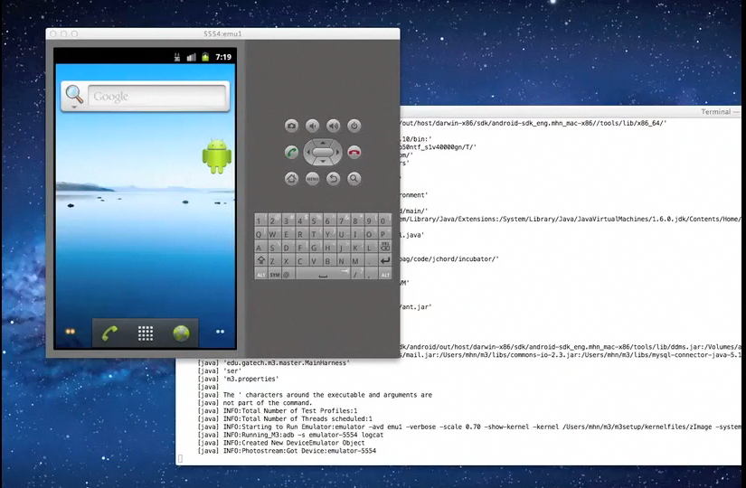
Demo: Dynodroid on Photostream App
Demo

Slide 16
Evaluation Study 1: App Code Coverage
50 open-source apps from F-Droid
SLOC ranging from 16 to 22K, mean of 2.7K
Evaluated Approaches:
Dynodroid (various configurations)
Monkey fuzz testing tool
Expert human users
Ten graduate students at Georgia Tech
All familiar with Android development

Slide 17
Testing Approaches Used in Our Evaluation
Approach | #Events | #Runs
Dynodroid - Frequency | 2,000 | 1
Dynodroid - UniformRandom | 2,000 | 3
Dynodroid - BiasedRandom | 2,000 | 3
Monkey | 10,000 | 3
Humans | No limit | >= 2

Slide 18
Dynodroid vs. Monkey
47% 8% 6%
Dynodroid achieves higher coverage than Monkey for 30 of the 50 apps.
Notes:
Both Dynodroid and Monkey cover 4-81% of code per app, for an average of 47%. Dynodroid exclusively covers 0-46% of code, for an average of 8%, which is attributed to system events that only Dynodroid can trigger. Monkey exclusively covers 0-61% of code, for an average of 6%, which is attributed to the richer set of UI events that Monkey can trigger (see Table 2 vs. Table 7). Another reason is that Dynodroid only generates straight (Drag) gestures but Monkey combines short sequences of such gestures to generate more complex (e.g., circular) gestures. Finally, Dynodroid uses fixed parameter values for UI events whereas Monkey uses random values, giving it superior ability to exercise custom widgets. In terms of the total code covered for each app, however, Dynodroid outperforms Monkey, achieving higher coverage for 30 of the 50 apps.

Slide 19
Dynodroid vs. Humans
51% 4% 7%
Automation Degree = C(Dynodroid Å Human) /C(Human)
Range = 8-100%, Average = 83%, S.D. = 21%
Notes:
Both Dynodroid and Human cover 4-91% of code per app, for an average of 51%. Dynodroid exclusively covers 0-26% of code, for an average of 4%, and Human exclusively covers 0-43% of code, for an average of 7%. In terms of the total code covered for each app, Human easily outperforms Dynodroid, achieving higher coverage for 34 of the 50 apps. This is not surprising, given that the users in our study were expert Android users, could provide intelligent text inputs and event sequences, and most importantly, could inspect Emma’s coverage reports and attempt to trigger events to cover any missed code.
But all the ten users in our study also reported tedious- ness during testing, how easy it was to miss combinations of events, and that it was especially mundane to click various options in the settings of apps one by one. Dynodroid could be used to automate most of the testing effort of Human, as measured by what we call the automation degree, measured as the ratio of coverage achieved by the intersection of Dynodroid and Human, to the total coverage achieved by Human. This ratio varies from 8% to 100% across our 50 apps, with mean 83% and standard deviation 21%. These observations justify Dynodroid’s vision of synergistically combine human and machine. It already provides support for intelligent text inputs, where a user with knowledge of an app can specify the text that it should use (instead of random text) in the specific text box widget prior to execution, or can pause its event generation when it reaches the screen, key in the input, and let it resume (as described in Section 3).

Slide 20
Sample Feedback from Participants
“Tried to cancel download to raise exception.”
“Human cannot trigger change to AudioFocus.”
“Many, many options and lots of clicking but no actions really involved human intelligence.”
“There are too many combinations of state changes (play -> pause, etc.) for a human to track.”

Slide 21
Dynodroid without vs. with System Events
47% 2% 8.3%
Notes:
https://docs.google.com/spreadsheet/ccc?key=0AoXwT5D6qkNmdERUaGUzOVQwbThIcHFkUE1DeGNzRGc#gid=0

Slide 22
Dynodroid without System Events vs. Monkey
43% 6% 10%
Notes:
https://docs.google.com/spreadsheet/ccc?key=0AoXwT5D6qkNmdERUaGUzOVQwbThIcHFkUE1DeGNzRGc#gid=0

Slide 23
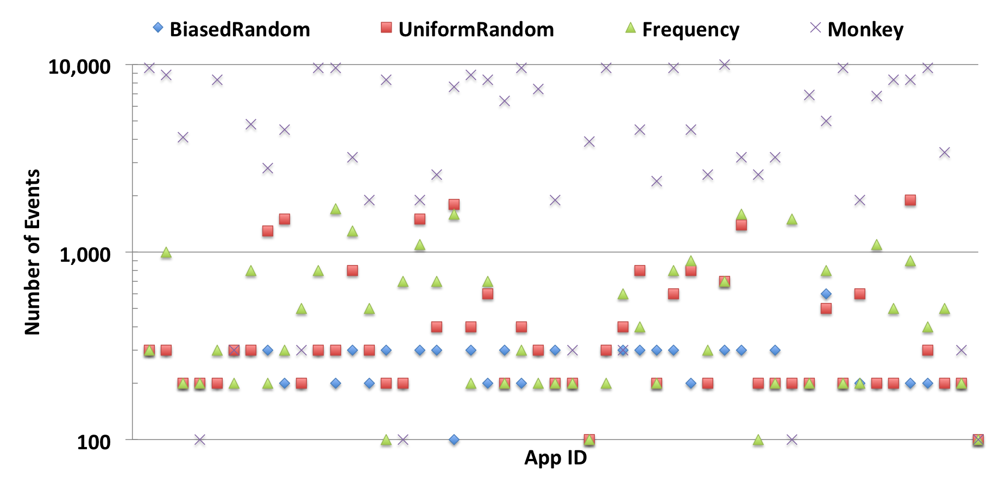
Minimum Number of Events to Peak Coverage
Monkey requires 20X more events than BiasedRandom
Frequency and UniformRandom require 2X more events than BiasedRandom

Slide 24
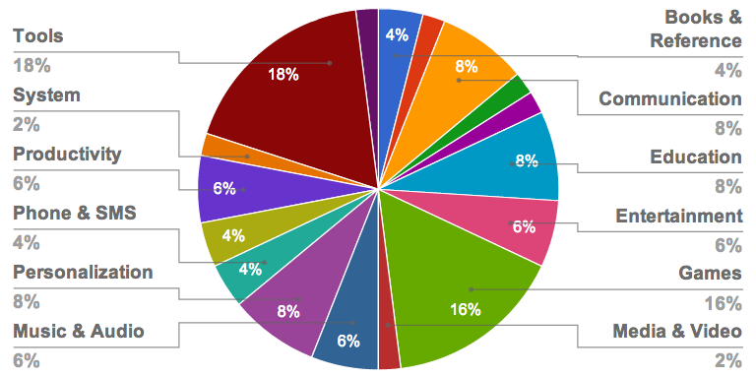
Evaluation Study 2: Bugs Found in Apps
1,000 most popular free apps from Google Play
Conservative notion of bug: FATAL EXCEPTION (app forcibly terminated)
Notes:
Popularity metric used is a score given to each app by Google that depends on various factors like number of downloads and ratings.
These apps are uniformly distributed over all 31 app categories in Google Play.

Slide 25
Bugs Found in 50 F-Droid Apps
App Name | Bugs | Kind | Description
PasswordMakerProForAndroid | 1 | Null | Improper handling of user data.
com.morphoss.acal | 1 | Null | Dereferencing null returned by an online service.
hu.vsza.adsdroid | 2 | Null | Dereferencing null returned by an online service.
cri.sanity | 1 | Null | Improper handling of user data.
com.zoffcc.applications.aagtl | 2 | Null | Dereferencing null returned by an online service.
org.beide.bomber | 1 | Array | Game indexes an array with improper index.
com.addi | 1 | Null | Improper handling of user data.

Slide 26
Bugs Found in 1,000 Google Play Apps
App Name | Bugs | Kind | Description
com.ibm.events.android.usopen | 1 | Null | Null pointer check missed in onCreate() of an activity.
com.nullsoft.winamp | 2 | Null | Improper handling of RSS feeds read from online service.
com.almalence.night | 1 | Null | Null pointer check missed in onCreate() of an activity.
com.avast.android.mobilesecurity | 1 | Null | Receiver callback fails to check for null in optional data.
com.aviary.android.feather | 1 | Null | Receiver callback fails to check for null in optional data.

Slide 27
Limitations
Does not exercise inter-app communication
Communication via key-value maps (“Bundle” objects)
Could synthesize such maps symbolically
Uses fixed, concrete data for events
E.g., geo-location, touch-screen coordinates, etc.
Could randomize or symbolically infer such data
Requires instrumenting the platform SDK
) Limited to particular SDK version
But lightweight enough to implement for other versions

Slide 28
Related Work
Model-based Testing
GUITAR [ASE’12], EXSYST [ICSE’12], …
Fuzz Testing
Monkey, …
Symbolic Execution
Acteve [FSE’12], Symdroid, …

Slide 29
Conclusion
Proposed a practical system for generating relevant inputs to mobile apps
Satisfying the five desirable criteria we identified: robust, black-box, versatile, automated, efficient
Showed its effectiveness on real-world apps
Significantly automates tasks that users consider tedious
Yields significantly more concise inputs than fuzz testing
Exposed handful of crashing bugs

Slide 30

Thank You!
http://pag.gatech.edu/dynodroid

